Slide 1
How to use Sign-it! signature saver for (Android Devices 8.0 or higher)
Sally Newcomb

Slide 2
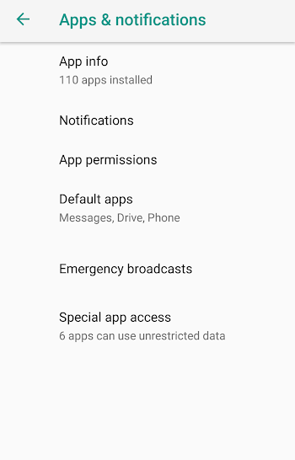
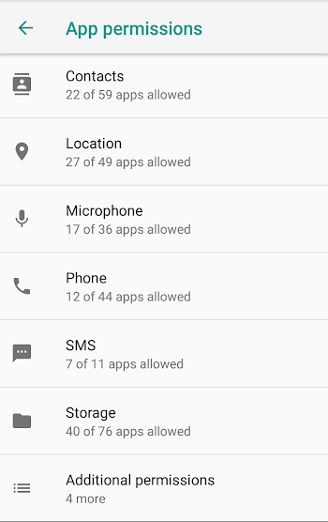
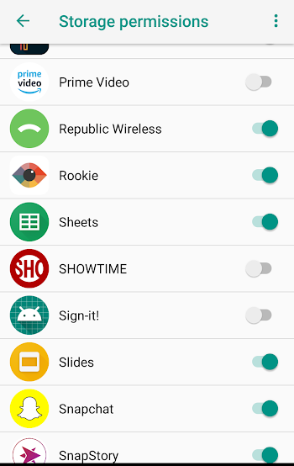
Step 1: App Permissions
For Sign-it! your phones’ internal storage is used. You will need to give the app permission to use internal storage.
Go into the settings app and click on Apps & notifications. Then, click on app permissions.
Next, scroll down and find the storage heading and click on it.
Scroll down to Sign-it! Slide the switch if it is not already green.

Slide 3
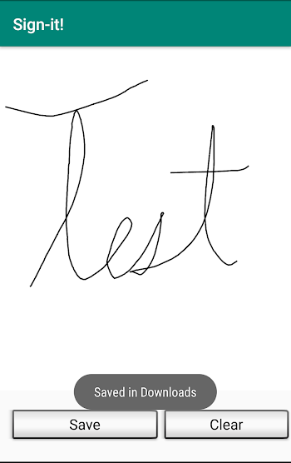
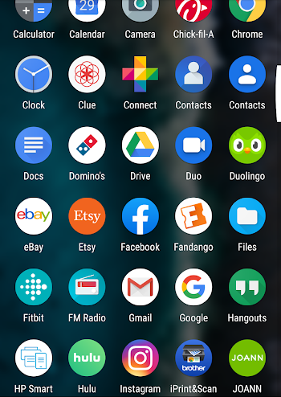
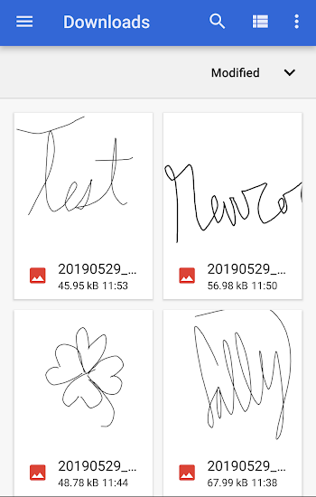
Step 2: Accessing saved photos
Click save when you have desired signature
Go to the files application
The signature image will show up in the downloads section of the files application

Slide 4
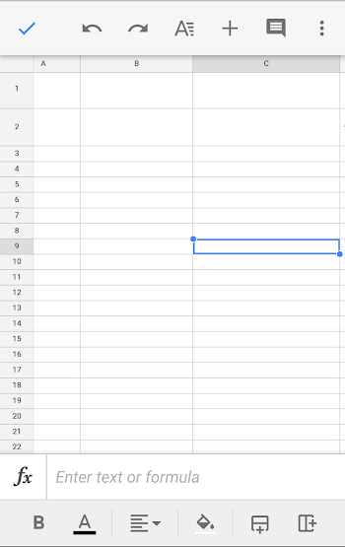
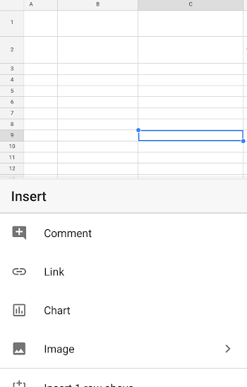
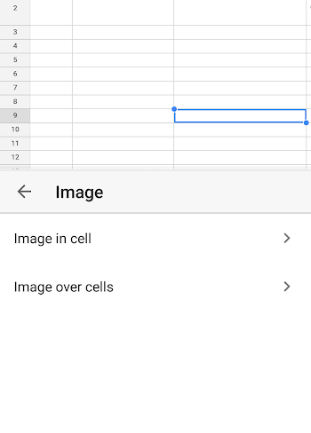
Step 3: Putting the signature is Google Sheets
First, select the box that you want to add a signature to and press the plus sign in the top right corner.
Then, select “Image” in the insert menu.
Next, click “ Image in cell,” this will keep whatever image you select within the cell boundaries.

Slide 5
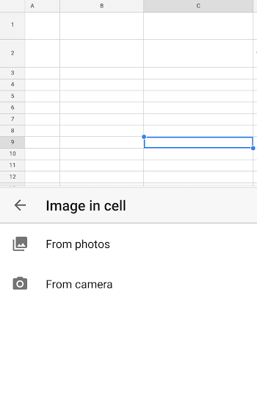
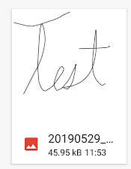
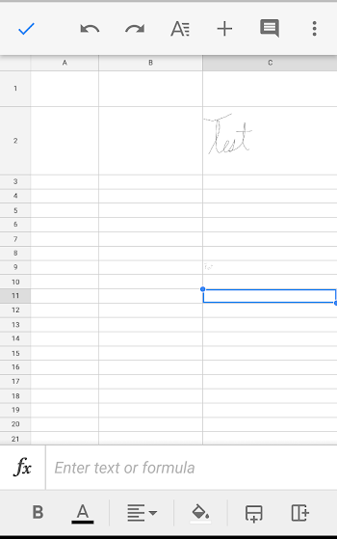
Step 3 Continued
Select “From photos.”
Select the signature from the downloads section of the photo directory.
And now the photo is inserted into the google sheets document.

